Slide 1

Name Services
Updated by Rajkumar Buyya
Redmond Barry Distinguished Professor
Introduction
Name services and the DNS
Directory/Discovery services
Summary
Most concepts are
drawn from Chapter 13

Slide 2
Which one is easy for humans and machines? and why?
74.125.237.83 or google.com
128.250.1.22 or distributed systems website
128.250.1.25 or buyya.com
128.250.1.10 or unimelb.edu.au
Disk 4, Sector 2, block 5 OR /usr/raj/Hello.java
raj@128.250.1.10 or raj@unimelb.edu.au

Slide 3

Names or Codes, or Numbers?
  Names (when meaningful) are easier to remember than codes or numbers…
  Number (or sequence codes) are more useful for structuring data and locating resources by a program..
  Example: IPv4
    128.250.29.30
    clouds. cis. unimelb.edu.au
Level 5 subnet
Machine Identifier
Australia
CIS network
Education Institutions
The University of Melbourne
Computing and Information Systems
Machine name

Slide 4




Names or Codes? or Numbers?
  As discussed in file system (hierarchical naming of files) and mounting at right location.
  Which one is better?
Disk 4, Sector 26, Block15
/usr/bin/tar

Slide 5
Aim
To introduce the name service as a distinct service that is used by client processes to obtain attributes such as the address of resources (computing systems, files, printers, etc.) or objects when given their name.

Slide 6
Learning objectives
To understand the need for naming systems in distributed systems
To be familiar with the design requirements such as structure and management of name spaces, and operations supported by them.
To understand the operation of the Internet naming service – DNS (Domain Name Service)
To understand structure and operation of directory service – X.500 Directory Service & LDAP (Lightweight Directory Access Protocol)
Notes:
Ditributed Systems are widely scattered, operating on different networks. How do we find a particular service or server?
How do name services work, what functions can they perform, how can we harness their power?
DNS is the most common and well-known naming service. How does it work?

Slide 7
1. Introduction
In a distributed system, names are used to refer to a wide variety of resources such as:
  Computers, services (e.g., http/ftp/ssh/smtp etc), remote objects, and files, as well as users.
Naming is fundamental issue in DS design as it facilitates communication and resource sharing.
  A name in the form of URL is needed to access a specific web page.
  Processes cannot share particular resources managed by a computer system unless they can name them consistently
  Users cannot communicate within one another via a DS unless they can name one another, with email address.
Names are not the only useful means of identification: descriptive attributes are another.
Notes:
Services/protocols: refer to them by name (http/ftp/ssh/smtp etc)

Slide 8
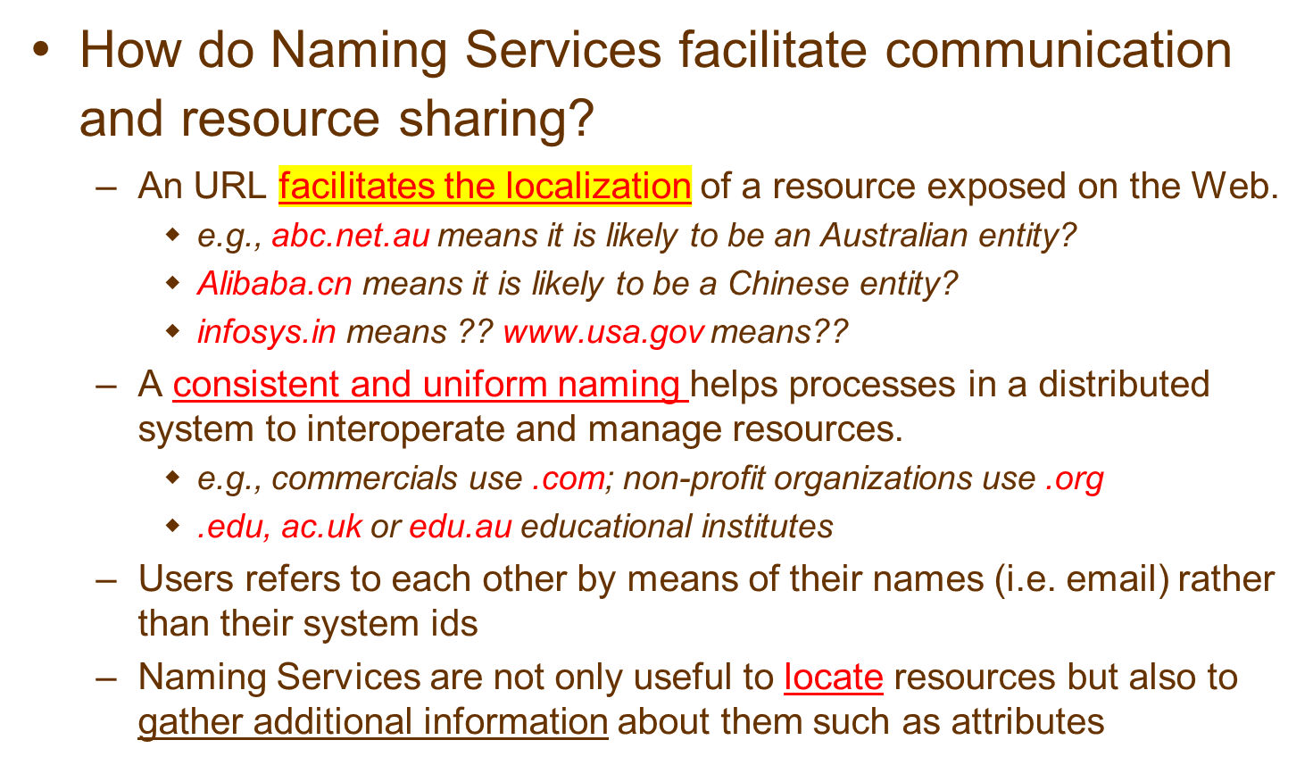
What are Naming Services?

Slide 9
What are Naming Services?
Definition
Key benefits
  Resource localization
  Uniform naming
  Device independent address (e.g., you can move domain name/web site from one server to another server seamlessly).
In a Distributed System, a Naming Service is a specific service whose aim is to provide a consistent and uniform naming of resources, thus allowing other programs or services to localize them and obtain the required metadata for interacting with them.

Slide 10
The role of names and name services
Resources are accessed using identifier or reference
  An identifier can be stored in variables and retrieved from tables quickly
  Identifier includes or can be transformed to an address for an object
    E.g. NFS file handle, RMI remote object reference
  A name is human-readable value (usually a string) that can be resolved to an identifier or address
    Internet domain name, file pathname, process number
    E.g ./etc/passwd, http://www.cdk5.net/, https://en.wikipedia.org/wiki/Distributed_computing
For many purposes, names are preferable to identifiers
  because the binding of the named resource to a physical location is deferred and can be changed
  because they are more meaningful to users
Resource names are resolved by name services
  to give identifiers and other useful attributes
Notes:
Identifier could be a hash, alphanumneric or binary code that can be rapidly looked up from a table, retrieving the actual address.

Slide 11




Role of Names and Naming Services
- Name Resolution
66.102.11.104
Client
name | IP | attributes
www.google.com
www.hotmail.com
……..
Naming Service
100.109.23.104

Slide 12
Requirements for name spaces
Allow simple but meaningful names to be used
Potentially infinite number of names
Structured
  to allow similar subnames without clashes
  to group related names
Allow re-structuring of name trees
  for some types of change, old programs should continue to work
Management of trust
Notes:
Students should read Section 9.2.1
Subnames: james.domain1.com, james.domain2.com
Com->domain1,domain2->->james

Slide 13
Composed naming domains used to access a resource from a URL
URL
http://www.cdk5.net:8888/WebExamples/earth.html
DNS lookup
Resource ID (IP number, port number, pathname)
138.37.88.61
8888
WebExamples/earth.html
ARP lookup
(Ethernet) Network address
2:60:8c:2:b0:5a
file
Socket
Web server
Address Resolution Protocol (ARP)
Notes:
ARP on the router finds the correct physical machine for the requested IP address

Slide 14
Composed naming domains used to access a resource from a URL
“Distributed Systems” subject slides at UniMelb
URL
http://clouds.cis.unimelb.edu.au/652/LectureSlides.html
DNS lookup
Resource ID (IP number, port number, pathname)
250.37.88.61
8888
652/LectureSlides.html
ARP lookup
(Ethernet) Network address
5:60:8c:2:b0:5a
file
Socket
Web server
Address Resolution Protocol (ARP)
Notes:
ARP on the router finds the correct physical machine for the requested IP address

Slide 15
Names and resources
Currently, different name systems are used for each type of resource:
  resource name identifies
  file pathname file within a given file system
  process process id process on a given computer
  port port number IP port on a given computer
Uniform Resource Identifiers (URI) offer a general solution for any type of resource. There two main classes:
    URL Uniform Resource Locator (URL)
      typed by the protocol field (http, ftp, nfs, etc.)
      part of the name is service-specific
      resources cannot be moved between domains
    URN Uniform Resource Name (URN)
      requires a universal resource name lookup service - a DNS-like system for all resources
More on URNs (Uniform Resource Names)
format: urn:<nameSpace>:<name-within-namespace>
examples:
a) urn:ISBN:021-61918-0
b) urn:cloudbus.unimelb.edu.au:TR2005-10
resolution:
send a request to nearest ISBN-lookup service - it would return
whatever attributes of a book are required by the requester
send a request to the urn lookup service at
cloudbus.unimelb.edu.au - it would return a url for the
relevant document
Notes:
Popup: showing examples of URNs
Show demo, ls/pwd, ps aux, netstat -n

Slide 16
2. Name Services and the Domain Name System
A name service stores a collection of one or more naming contexts, sets of bindings between textual names and attributes for objects such as computers, services, and users.
The major operation that a name service supports is to resolve names.

Slide 17
Navigation
Namespaces allows for structure in names.
URLs provide a default structure that decompose the location of a resource in
  protocol used for retrieval
  internet end point of the service exposing the resource
  service specific path
This decomposition facilitates the resolution of the name into the corresponding resource
Moreover, structured namespaces allows for iterative navigation…
Navigation is the act of chaining multiple Naming Services in order to resolve a single name to the corresponding resource.

Slide 18
Iterative navigation
NS2
2
Name
Client
1
NS1
servers
3
NS3
A client iteratively contacts name servers NS1–NS3 in order to resolve a name
Reason for NFS iterative name resolution
This is because the file service may encounter a symbolic link (i.e. an alias) when resolving a name. A symbolic link must be interpreted in the client’s file system name space because it may point to a file in a directory stored at another server. The client computer must determine which server this is, because only the client knows its mount points.
Used in:
DNS: Client presents entire name to servers, starting at a local server, NS1. If NS1 has the requested name, it is resolved, else NS1 suggests contacting NS2 (a server for a domain that includes the requested name).
NFS: Client segments pathnames (into 'simple names') and presents them one at a time to a server together with the filehandle of the directory that contains the simple name.
Notes:
Show NFS issue on board
Client asks for file at /server1/mnt/file -> which points to -> /server2/mnt/file

Slide 19
Server controlled navigation
In an alternative model, name server coordinates naming resolution and returns the results to the client. It can be:
  Recursive:
    it is performed by the naming server
    the server becomes like a client for the next server
    this is necessary in case of client connectivity constraints
  Non recursive:
    it is performed by the client or the first server
    the server bounces back the next hop to its client

Slide 20
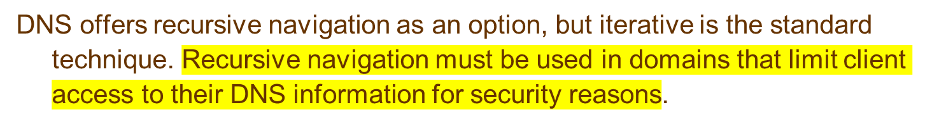
Non-recursive and recursive server-controlled navigation
NS2
NS2
2
2
1
4
3
NS1
1
NS1
client
client
4
3
5
NS3
NS3
Non-recursive
Recursive
server-controlled
server-controlled
A name server NS1 communicates with other name servers on behalf of a client
Notes:
Iterative (prev slide) - client contacts name servers ns1-ns3 itself until it can resolve address
Server controlled - name server contacts other ns until it can resolve address
Recursive server controlled - name server passes request down chain, is unaware of who eventually resolves IP

Slide 21
DNS - The Domain Name System
A distributed naming database (specified in RFC 1034/1305)
Name structure reflects administrative structure of the Internet
Rapidly resolves domain names to IP addresses
  exploits caching heavily
  typical query time ~100 milliseconds
Scales to millions of computers
  partitioned database
  caching
Resilient to failure of a server
  replication
Basic DNS algorithm for name resolution (domain name -> IP number)
Look for the name in the local cache
Try a superior DNS server, which responds with:
  – another recommended DNS server
  – the IP address (which may not be entirely up to date)
Notes:
Naming structure like a tree - authorative/root DNS, then auth DNS for .com, au, uk, tw, etc etc
Look in local cache
Try superior DNS server (i.e. your ISP)
Try superior DNS server (root/authorative server)

Slide 22
DNS name servers: Hierarchical organisation
a.root-servers.net
(root)
au
ns1.nic.au
purdue.edu
(au)
yahoo.com
....
Note: Name server names are in italics, and the corresponding domains are in parentheses.
Arrows denote name server entries
ns.purdue.edu
com.au
(purdue.edu)
edu.au
...
ns0.ja.net
(edu.au)
* .purdue.edu
authoritative path to lookup:
raj-pc.cis.unimelb.edu.au
usyd.edu.au
unimelb.edu.au
...
abc.unimelb.edu.au
clouds.cis.unimelb.edu.au
dns0-doc.usyd.edu.au
(unimelb.edu.au)
(cis.unimelb.edu.au)
(usyd.edu.au)
cis.unimelb.edu.au
*.cis.unimelb.edu.au
*.usyd.edu.au
*.unimelb.edu.au

Slide 23
DNS in typical operation
a.root-servers.net
(root)
Without caching
au
ns1.nic.au
purdue.edu
(au)
yahoo.com
....
ns.purdue.edu
com.au
(purdue.edu)
edu.au
...
ns0.ja.net
(edu.au)
* .purdue.edu
usyd.edu.au
unimelb.edu.au
...
IP: alpha.unimelb.edu.au
2
alpha.unimelb.edu.au
clouds.cis.unimelb.edu.au
dns0-doc.usyd.edu.au
client.usyd.edu.au
(unimelb.edu.au)
(cis.unimelb.edu.au)
(usyd.edu.au)
IP:raj-pc.cis.unimelb.edu.au
IP:ns0.ja.net
cis.unimelb.edu.au
1
4
*.cis.unimelb.edu.au
*.usyd.edu.au
*.unimelb.edu.au
raj-pc.cis.unimelb.edu.au ?
3
IP:mulga.csse.unimleb.edu.au

Slide 24
DNS server functions and configuration
Main function is to resolve domain names for computers, i.e. to get their IP addresses
  caches the results of previous searches until they pass their 'time to live'
Other functions:
  get mail host for a domain
  reverse resolution - get domain name from IP address
  Host information - type of hardware and OS
  Well-known services - a list of well-known services offered by a host
  Other attributes can be included (optional)
Notes:
Explain caching and TTL
Mail: where is the mail server for someone@cis.unimelb.edu.au
Reverse: What is the friendly name for 128.250.1.22 (mulga.cis.unimelb.edu.au), nslookup 128.250.1.22
Services: whois mulga.cis.unimelb.edu.au
We will see the other types of attributes in the next slide

Slide 25
DNS resource records
Record type
Meaning
Main contents
A
A computer address (IPv4)
IPv4 number
AAA
A computer address (IPv6)
IPv6 number
NS
An authoritative name server
Domain name for server
CNAME
The canonical name for an alias
Domain name for alias
SOA
Marks the start of data for a zone
Parameters governing the zone
PTR
Domain name pointer (reverse
Domain name
lookups)
HINFO
Host information
Machine architecture and operating
system
MX
Mail exchange
List of <
preference, host
> pairs
TXT
Text string
Arbitrary text
Notes:
%nslookup; >set type=MX; >broberg.com.au
MX can list many candidate mail servers, weighted with a priority (show demo using nslookup)
Can storage host archictecture info (HINFO) or location (LOC)
Should we do that? These days, it is recommended not to!!!!!

Slide 26
DNS issues
Name tables change infrequently, but when they do, caching can result in the delivery of stale data.
  Clients are responsible for detecting this and recovering
Its design makes changes to the structure of the name space difficult. For example:
  merging previously separate domain trees under a new root
  moving subtrees to a different part of the structure (e.g. if Scotland became a separate country, its domains should all be moved to a new country-level domain.)
Notes:
A service might be moved from one server to another, changing IPs!
Need to update DNS entry, cached info becomes invalid!
Explain implications for DNS based load balancing!!
Merging two countries domain trees would be complicated, and there might be duplicates
Adding new country domain trees would be challenging also

Slide 27
Directory services (registration and discovery)
Sometime users wish to find a particular person or resource, but they don’t know its name, only some of its attributes.
  What is the name of the user with a telephone number 03-83441344?
  What is the name of professor teaching Cloud computing at UniMelb (e.g., ask Google!)
Sometime users require a service, but they are not concerned with what system entity provides it.
  Where can I print high resolution colour image?
Directory services can help with above situation: they store collections of bindings and attributes and also looks up entries that match attribute-based specs.
Directory service:- 'yellow pages' for the resources in a network
  Retrieves the set of names that satisfy a given description
  e.g. X.500, LDAP, MS Active Directory Services
    (DNS holds some descriptive data, but:
      the data is very incomplete
      DNS isn't organised to search it)
Discovery service:- a directory service that also:
  is automatically updated as the network configuration changes
  meets the needs of clients in spontaneous networks
  discovers services required by a client (who may be mobile) within the current scope, for example, to find the most suitable printing service for image files after arriving at a hotel.
  Examples of discovery services: Jini discovery service, the 'service location protocol', the 'simple service discovery protocol' (part of UPnP), the 'secure discovery service'.
Notes:
Where is there a printer that prints A5 size?
DNS is best for just resolving names to IP’s, it is busy enough already!
We saw that we could store arbritrary info in DNS but it is definitely not recommended
We spoke about bonjour, local discovery service for ubiq/mobile users
SSDP is used by many media sources and players/renderers

Slide 28
X.500 Directory Service
X.500 and LDAP (Lightweight Directory Access Protocol)
  a hierarchically-structured standard directory service designed for world-wide use
  X.500 is standardised by ITU (International Telecommunication Union) and ISO
  accommodates resource descriptions in a standard form and their retrieval for any resource (online or offline)
  never fully deployed, but the standard forms the basis for LDAP, the Lightweight Directory Access Protocol, which is widely used – IETF RFC 2251.
  A secure access to directory through authentication is also supported.

Slide 29
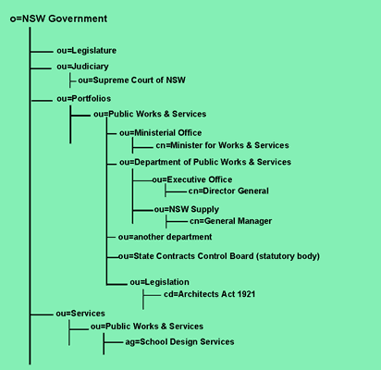
Part of the X.500 Directory Information Tree (DIT)
X.500 Service (root)
Australia (country)
India
USA
Object class for NSW govt.
NSW (state)
Vic (state)
Govt
Private
Educational
UniMelb
Monash
CIS
Medicine
Staff
Students

Slide 30
Summary
Names services facilitate communication and resource sharing in distributed systems.
They are playing very important role in Distributed systems such as the Internet, Web, CDNs (Content Delivery Networks), Web Services, Location-aware services– publication and discovery
Name services:
  defer the binding of resource names to addresses (and other attributes)
  Names are resolved to give addresses and other attributes
  Goals :
    Scalability (size of database, access traffic (hits/second), update traffic)
    Reliability
    Trust management (authority of servers)
  Issues
    exploitation of replication and caching to achieve scalability without compromising the distribution of updates
    navigation methods
Directory and discovery services:
  'yellow pages' retrieval by attributes
  dynamic resource registration and discovery

